Slide 1

Title
subtitle
DEI Advisory Committee Meeting
September 3, 2025 | 11:00 PM – 12:30 PM

Slide 2
Welcome In!
Please, take a moment to arrive.

Slide 3
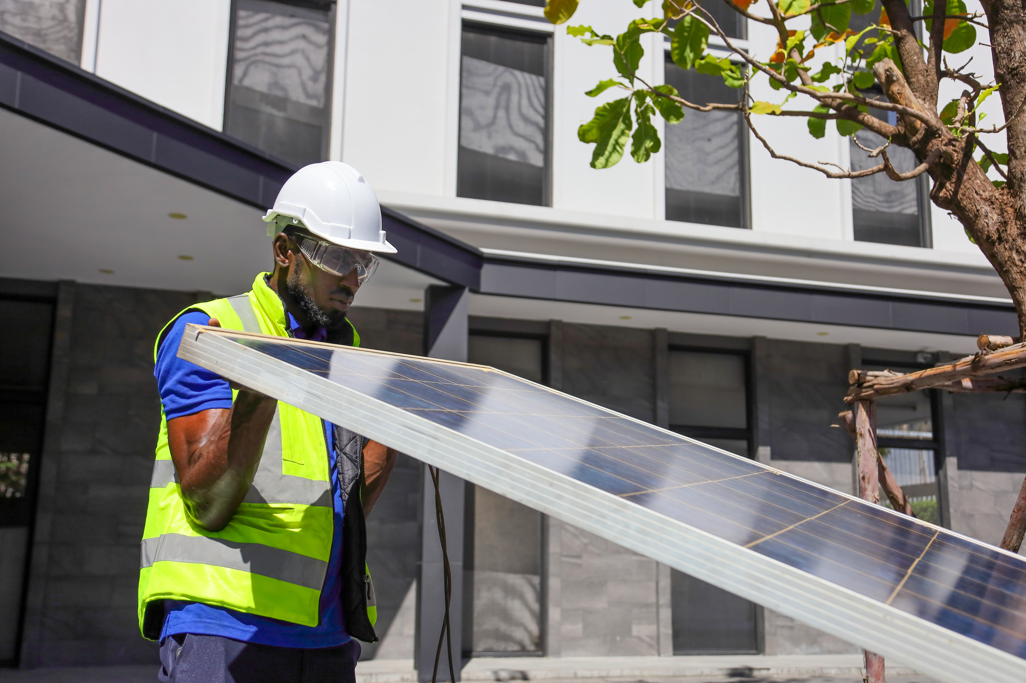
Housekeeping
Mind the mic
Use the chat
Ask for tech support if needed
Working Agreements
Focus on Systems: Move out of the individual focus and zoom out to consider systemic cause for barriers or burdens felt by individuals. | Move up/Move up: Be aware of one’s own contributions. If you find yourself talking more, move up your listening. If you find yourself listening more, work to move up your contributions. | With and not for: We are representatives in this space and we are tasked with advocating for perspectives and turning back to our spheres to bring them along with us in this space. | Confidentiality within this space: Maintain confidentiality of what committee members share. Allow members to speak their minds. | Agree to Disagree: We may not always agree. There may be non-closure and we can expect and work to accept that.

Slide 4

Agenda
Welcome
Introductions
Updates from the Bureau Chief
Advisory Committee Discussion
Topic Generation
Closing

Slide 5
Introductions
IPA Staff: Name, Pronouns, Title, Areas of work
Committee Members: Name, Pronouns, Organization
Reflection Prompt:
What recent experiences or insights related to your work shines a light on the promise of equitable shifts happening in the clean energy sector?

Slide 6
Updates from the Bureau
LTP Draft & Stakeholder Feedback
Racial Disparity Study
Southern IL Clean Energy Summit
DEI Data Dashboard
Business Enterprise Program (BEP) Efforts
Internal Equity-Centered Leadership Academy

Slide 7
Group Discussion
What initiatives would drive support for small and emerging businesses that qualify as EECs and who we’d like to support through our programs?
  Here's what's happening:
      Clean Energy Jobs & Justice Fund
      Illinois Shines Equity Training Series
      AoC Resources
  What else should we be investigating?
How do we create the pull for more EEPs into the clean energy economy?
  Here's what's happening:
    Outreach Efforts
    Union Engagement
  What else should we be investigating?

Slide 8
Future Topic Generation
What emerging equity topics or gaps should we discuss next?
Any intersectional issues (e.g. workforce, policy, small business) we should elevate?
Ideas for speakers, research, or data to inform upcoming agendas?
Happy 1 Year, IPA's DEI Advisory Committee!
  Anyone else who should be in the conversation?

Slide 9
Closing & Next Steps
Gratitude for your continued insight and partnership.
Meeting notes and materials will be posted on the website.
Please complete the short feedback form after the meeting.

