Slide 1

IPA Power Hour—The One Big Beautiful Bill Act—What it Means for Clean Energy, Tax Credits, and the Road Ahead
September 26, 2025

Slide 2
Agenda
Introductions and Housekeeping
Big picture of the OBBBA
Impacts on Clean Energy Industry
5-minute Q&A
Illinois’ Road Ahead
Final Q&A

Slide 3
IPA Power Hour Webinars
Today’s Power Hour:
This 60-minute webinar will explore major changes to federal clean energy incentives introduced by the recently enacted H.R. 1 ("One Big Beautiful Bill Act" or "OBBBA"). Attendees will gain insight into how the OBBBA could affect clean energy development, how federal tax incentives are scheduled to phase out, and considerations for how the broader clean energy landscape may evolve in response.
Power Hour is a series of educational and informative presentations on a wide range of clean energy topics and emerging issues.
Power Hour webinar series started in 2021.
To-date, the Agency has hosted 36 Power Hour webinars, garnering over 1,300 attendees and over 2,000 post-webinar views on the IPA YouTube channel.
Invited energy thought leaders and experts locally and nationally.
WEBINAR ARCHIVES: https://ipa.illinois.gov/about-ipa/ipa-events/previous-power-hour-events.html

Slide 4
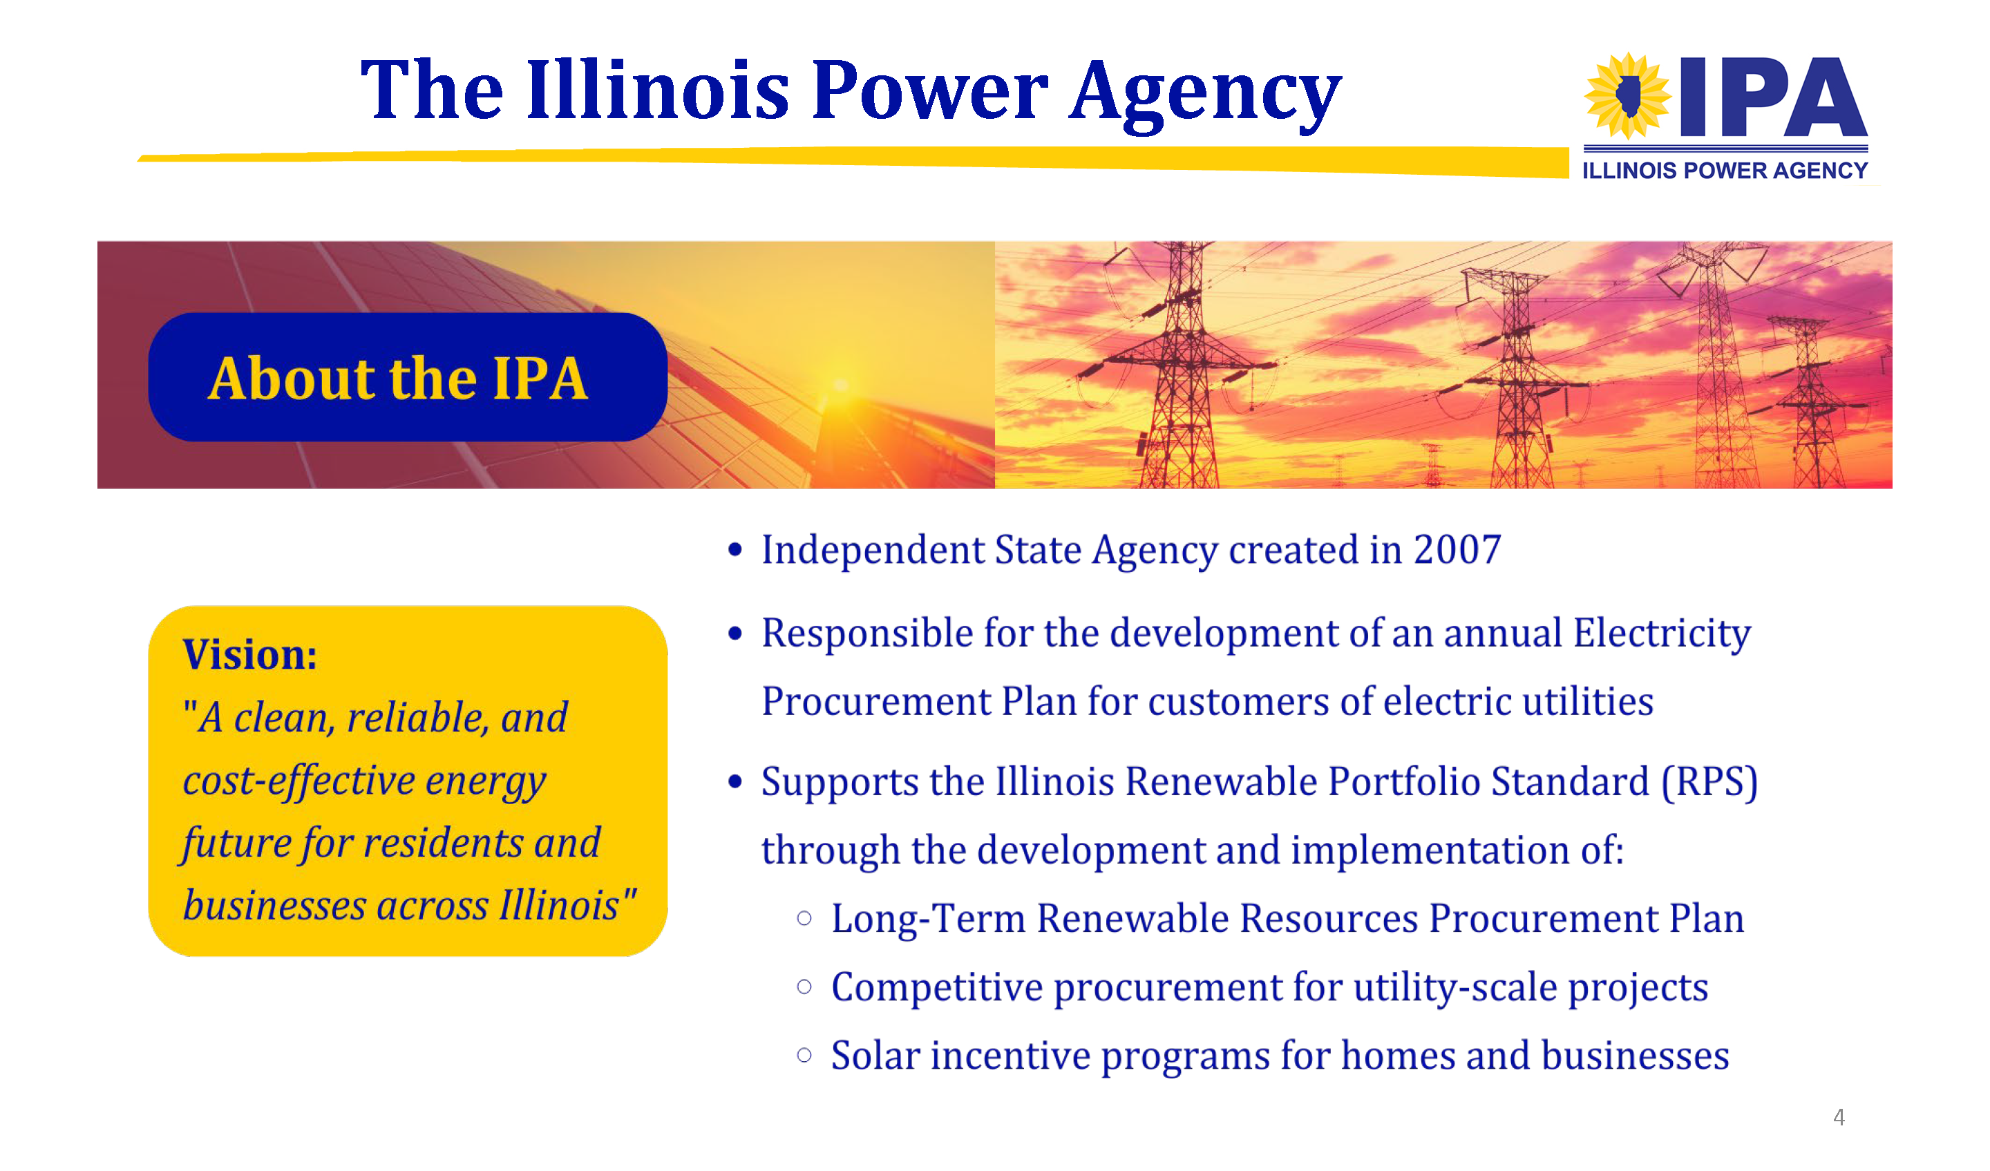

Slide 5
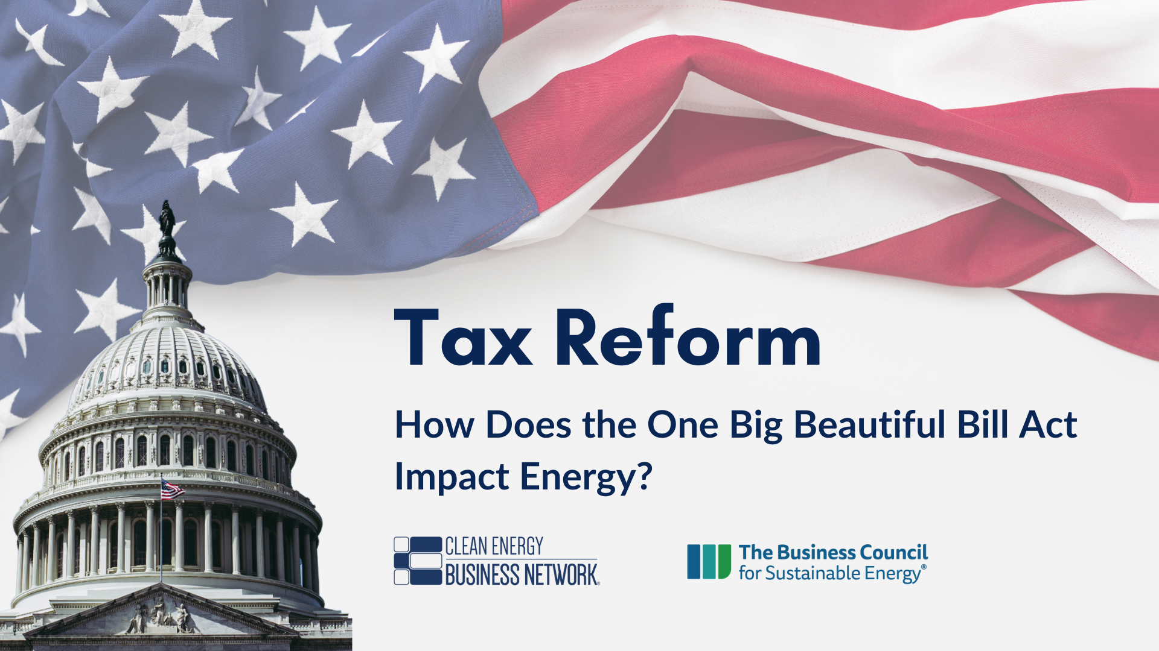


Slide 6

Agenda
CEBN Overview
OBBBA Overview
New Energy Tax Credit Timelines under OBBBA
IRS Guidance on Commence Construction
Q&A

Slide 7






The small business voice for the clean energy economy
Policy Support
Market & Technology Education
Business Development Assistance
©2025 CEBN
Notes:
The Clean Energy Business Network is a nationwide, nonprofit organization that serves as the small business voice for the clean energy economy.
Our network spans more than 8,200 business and community leaders working across all 50 states, over 400 congressional districts, and a broad spectrum of energy technologies and services.

Slide 8

The One Big Beautiful Bill Act
Signed into law July 4, 2025, OBBBA:
Rapidly eliminates or phases out some energy tax credits.
Leaves others relatively untouched.
Restricts involvement of “foreign entities of concern.”
Maintains transferability.
Permanently restores Sec. 174 R&D deduction.
Visit our Tax Package Resource Center to learn more.
Photo: White House Gallery
Notes:
Starting around late Feb., Congress began working on a major tax reform proposal to implement Pres. Trump’s priorities for permanently extending many of the tax provisions in the Tax Cuts and Jobs Act of 2017. We saw several iterations of this move through the committee and floor consideration in the House and Senate. President Trump signed the “One, Big, Beautiful Bill Act” into law on July 4th.
The final legislation leaves some energy industries relatively unscathed, but rapidly eliminates credits for efficiency, residential solar, and electric vehicles (within 2025-2026) and abruptly phases out wind and solar (requiring projects to commence construction within one year of enactment to qualify for current safe-harbor rules).
One bright spot was the full and permanent restoration of the R&D tax deduction, with retroactive tax relief for small businesses.
Please visit our Tax Package Resource Center for a detailed overview and summary table.

Slide 9
Consumer-Facing Credits
Rapid elimination
Condensed deadline
Untouched
Extended
Residential, commercial, and vehicle credits eliminated within 6-12 months.
TAX CREDIT | PREVIOUS TIMELINE | NEW TIMELINE
25E - Used EVs | Vehicle acquired by Dec. 31, 2032 | Vehicle acquired by Sep. 30, 2025
30D - New EVs | Vehicle acquired by Dec. 31, 2032 | Vehicle acquired by Sep. 30, 2025
30C - EV charging infrastructure | Placed in service by Dec. 31, 2032 | Placed in service by June 30, 2026
45W - Commercial EVs | Vehicle acquired by Dec. 31, 2032 | Vehicle acquired by Sep. 30, 2025
25C - EE Home Improvement | Placed in service by Dec. 31, 2032 | Placed in service by Dec. 31, 2025
25D - Residential Clean Energy | Placed in service by Dec. 31, 2034 | Expenditures made by Dec. 31, 2025
45L - New EE Home | Home acquired by Dec. 31, 2032 | Home acquired by June 30, 2026
179D – EE Commercial Building | Construction begins by Dec. 31, 2032 | Construction begins by June 30, 2026
©2025 CEBN
Notes:
Next few slides show several tables summarizing the major timelines for tax credits under OBBBA vs previous timelines under the IRA. Want to flag the key in upper righthand corner (briefly explain this).
Credits for residential energy efficiency and clean energy (Sec. 25C and D) would be eliminated at the end of 2025, and EVs (Sec. 25E, 30D, 45W) would be eliminated after Sep. 30, 2025.
New energy efficient homes (Sec. 45L), EV charging infrastructure (30C), and commercial energy efficient buildings (Sec. 179d) would expire June 30, 2026.

Slide 10
Sec. 48E/45Y Tech-Neutral Credits
Solar and wind rapidly phased out.
Other technologies maintain previous schedule.
Rapid elimination
Condensed deadline
Untouched
Extended
TAX CREDIT | PREVIOUS TIMELINE | NEW TIMELINE
45Y – Tech-neutral Production Tax Credit 48E – Tech-neutral Investment Tax Credit | Projects must commence construction in 2025-2032 (or until certain emissions reductions met) and be placed in service within four years (aka “safe harbor”). | Wind and Solar: Projects must begin construction by July 4, 2026 to retain the current safe harbor OR must be placed in service by Dec. 31, 2027.
 |  | Other technologies (geothermal, hydro, storage, etc.): Projects must begin construction* by Dec. 31, 2033 to receive full value of credit, then phased down (75% of credit in 2034, 50% in 2035, then 0%).
©2025 CEBN
©2025 CEBN
Notes:
The legislation treats wind and solar separately from other Sec. 48E/45Y technologies. Wind and solar projects that commence construction before July 4th, 2026 (one year after enactment) retain the current safe-harbor provisions to claim the credit (project must be placed in service within four years).
Projects that start after this timeframe must be placed in service by December 31, 2027 to receive the credit.
This legislation also prohibits the use of Sec. 48 for wind and solar lease financing.
Current law would be largely preserved for other Sec. 48E/45Y technologies such as geothermal, battery storage, and hydropower, maintaining the full value of the credits through 2033, with a phaseout by 2036. The final bill also includes a slight language modification sought by the waste heat to power industry clarifying the lifecycle emissions rate calculations for eligible projects prior to date of enactment.
Finally, transferability would be preserved across the credits.
A note on safe harbor: Current safe harbor for Sec. 48E/45Y technologies requires projects be placed in service within 4 years of beginning construction. The requirements for this have changed under recent IRS guidance - more to come on this topic shortly.

Slide 11
Other Sec. 48/45 Credits
Rapid elimination
Condensed deadline
Untouched
Extended
TAX CREDIT | PREVIOUS TIMELINE | NEW TIMELINE
45V - Clean Hydrogen | Construction begins by Dec. 31, 2032 | Construction begins by Dec. 31, 2027
48(a) – Geothermal Heat | Construction begins by Dec. 31, 2034 | Construction begins by Dec. 31, 2034
45U – Nuclear Power Production | Construction begins by Dec. 31, 2032 | Projects that begin construction by Dec. 31, 2033 receive full value of credit, then phased down (75% of credit in 2034, 50% in 2035, then 0%).
45Q – Carbon Capture | Construction begins by Dec. 31, 2032 | Construction begins by Dec. 31, 2032
45X - Advanced Manufacturing | Goods produced/sold by Dec. 31, 2029 receive full value of credit, then phased down (75% of credit in 2030, 50% in 2031, 25% in 2032, then 0%). Critical minerals: permanent | Wind: Goods sold by Dec. 31, 2027
 |  | Critical minerals: Goods sold by Dec. 31, 2030 receive full value of credit, then phased down (75% in 2031, 50% in 2032, 25% in 2033, then 0%).
 |  | Other: Maintains current schedule for battery/solar components; adds metallurgical coal as eligible material.
45Z – Clean Fuels (SAF) | Fuel sold in 2025-2027 | Fuel sold in 2025-2029
©2025 CEBN
Notes:
The hydrogen PTC (45V) was significantly reduced with the credit expiring at the end of 2027 rather than in 2032. This was still a major improvement over an earlier House version that would have ended the credit this year.
Nuclear and carbon capture largely retained the existing schedule.
Under the advanced manufacturing tax credit, the phase-down schedule was preserved for some technologies such as battery and solar components. Wind was dramatically shortened, with the credit now only available to goods sold through 2027. Critical minerals previously had a permanent credit, but will now be phased down from 2030 to the end of 2033.
Clean fuels (Sec. 45Z) were given a modest extension over their current 2027 deadline, terminating at the end of 2029.

Slide 12
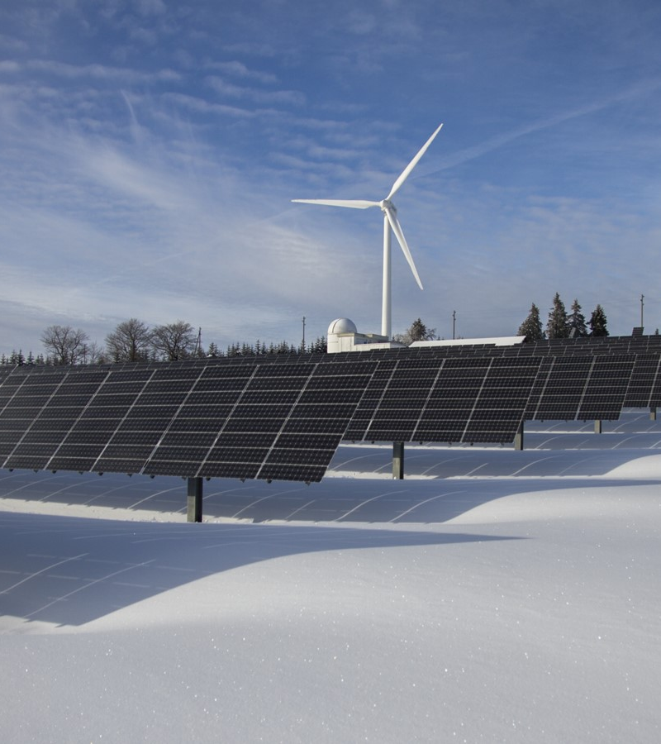
Executive Order on Wind and Solar
Issued by President Trump on July 7.
Directed Treasury Dept. to take action within 45 days on implementation of wind and solar credit deadlines and FEOC provisions in OBBBA.
“This includes issuing new and revised guidance as the Secretary of the Treasury deems appropriate and consistent with applicable law to ensure that policies concerning the 'beginning of construction' are not circumvented, including by preventing the artificial acceleration or manipulation of eligibility and by restricting the use of broad safe harbors unless a substantial portion of a subject facility has been built.”
©2025 CEBN and BCSE
©2025 CEBN
Notes:
On July 7, 2025, President Trump issued an Executive Order titled “Ending Market Distorting Subsidies for Unreliable, Foreign Controlled Energy Sources” regarding the implementation of the energy tax credit provisions in the One Big Beautiful Bill Act.
The EO directs the Treasury Department within 45 days to take all action deemed necessary and appropriate to enforce the termination of the Sec. 48E/45Y credits for wind and solar and to implement the Foreign Entity of Concern provisions.
The EO specifies: “This includes issuing new and revised guidance as the Secretary of the Treasury deems appropriate and consistent with applicable law to ensure that policies concerning the 'beginning of construction' are not circumvented, including by preventing the artificial acceleration or manipulation of eligibility and by restricting the use of broad safe harbors unless a substantial portion of a subject facility has been built.”
Under previous IRS guidance, a project may qualify for beginning construction either by meeting a “physical work test” (beginning construction work of a significant nature) or a “5% safe harbor” (triggered when a taxpayer has incurred 5% of the total cost of the energy property and thereafter makes continuous efforts to advance towards completion).
The EO further directed the Department of Interior to examine and revise any policies that “provide preferential treatment to wind and solar facilities in comparison to dispatchable energy sources.” CEBN will continue to provide updates on implementation guidance as available.

Slide 13
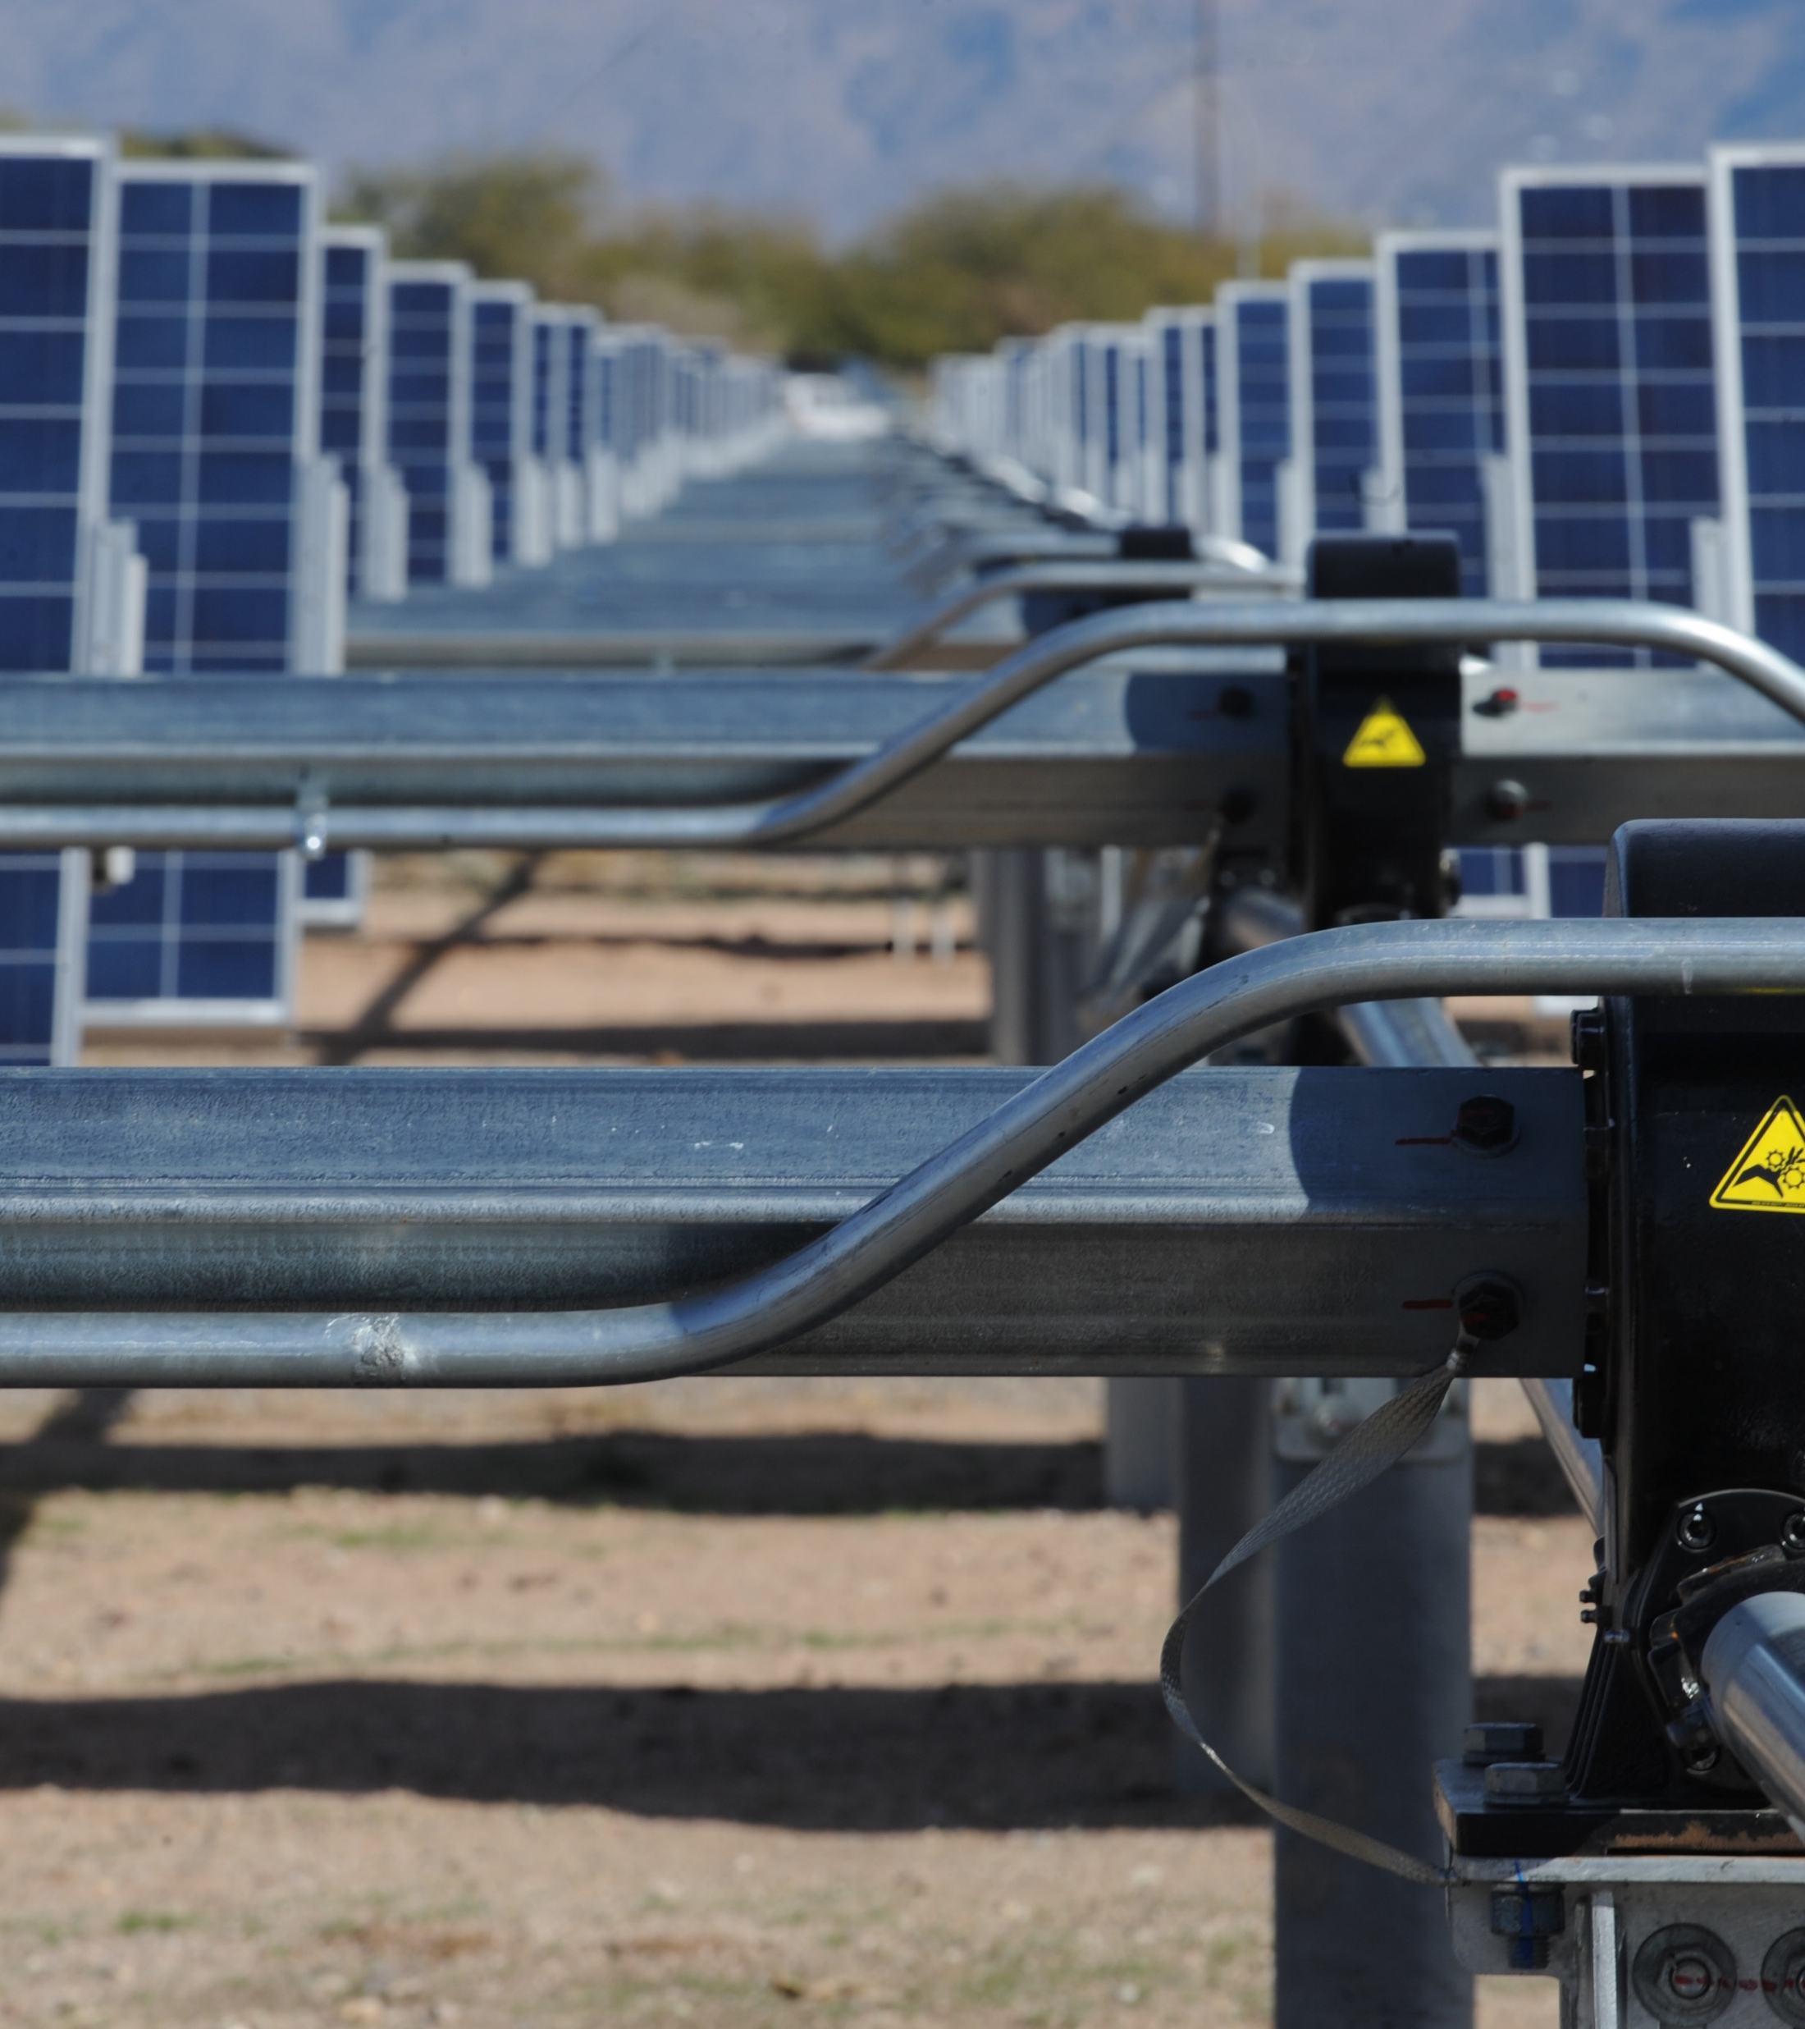
IRS Notice 2025-42: Wind & Solar Commence Construction
Issued by Treasury Dept. on Aug. 15
Effective Sep. 2, 2025
Eliminates 5% safe harbor pathway (exception for solar projects < 1.5 MW)
Physical work test = only pathway
Excludes “preliminary activities”
Excludes existing inventory
“Continuous program of construction”
Four-year timeline remains in place
©2025 CEBN and BCSE
©2025 CEBN

Slide 14

“Preliminary Activities”
planning or designing
securing financing
exploring
researching
conducting mapping/modeling to assess a resource
obtaining permits and licenses
conducting geophysical, gravity, magnetic, seismic and resistivity surveys
conducting environmental and engineering studies
clearing a site
conducting test drilling to determine soil conditions
excavating to change the contour of the land (as distinguished from excavation for a foundation)
removing existing foundations, turbines, and towers, solar panels, or any components that will no longer be part of the applicable wind or solar facility
©2025 CEBN

Slide 15

“Continuous Program of Construction” Exceptions
severe weather conditions
natural disasters
obtaining government permits or licenses
written request of a government entity regarding matters of public safety, security, or similar concerns
interconnection-related delays
manufacture of custom components
labor stoppages
inability to obtain specialized equipment of limited availability
presence of endangered species
financing delays
supply shortages
©2025 CEBN

Slide 16
Q&A

Slide 17
The Road Ahead: How can Illinois Pivot to Federal Policy Shifts?
Sarah Duffy, IPA Director of External Affairs

Slide 18




Potential New Legislation
Omnibus to be considered during October veto session
Financial support:
Energy storage procurements
Energy Storage for All
Thermal Energy Network Pilot and Revolving Loan Fund
Virtual Power Plant
Removing Structural Barriers:
Lift ban on new nuclear generation plants
Limited one-time post-award REC contract renegotiation
Accelerating interconnection (at distribution level)
Siting and permitting
Integrated Resource Planning

Slide 19


Maximizing Uptake of Remaining Tax Credits
IPA will conduct webinars and roundtables for targeted audiences
Elective/Direct Pay option for tax credits
Prioritize projects at public schools
November 2025 – June 2026, exact dates TBD
IFA partnership with Baker Tilly to provide accounting and compliance guidance
Focused on Elective/Direct Pay

Slide 20
Other sources of financing & funding
DCEO Grants:
Community Solar Energy Sovereignty Grant
Energy Transition Community Grant
Purpose: development of solar community projects that promote community ownership
Eligible Applicants: Community organizations ("CBO") and public entities (if no CBO there has applied)
Currently accepting applications until December 31, 2025
Award amount: $50,000 - $1,000,000
Total available: $8.5 million annually
Allowable Costs: Outreach, Land acquisition, Financing, Staff and Operations, Permits, zoning, Interconnection, Equipment, and more
Purpose: Address the economic impact of the plant or mine closure
Eligible Applicants: Local governments within 30 miles of closed/closing gas, nuclear, or coal mine or plan
Opens annually, last window closed June 2025.
Award amount: $50,000+
Allowable Costs: Workforce development, Public infrastructure, environmental clean up, affordable housing, community planning, and more

Slide 21
Other sources of financing & funding
Illinois Climate Bank: Energy Efficiency Revolving Loan Fund
Bridge Loans
Financing to fill gaps until other sources of capital (ITC through Direct Pay, ILSFA REC incentives, other)
Up to $1,000,000; term of 18-24 months
Co-lending and Participation Loans
Up to $1,000,000; term of up to 7 years
Eligible entities: local governments, municipal and cooperative utilities, public school districts, non-profits, and for-profit entities
Projects at commercial building that has undergone energy audit

Slide 22
Q&A

Slide 23
Contact Information
Andy Barnes
Director of Policy & Communications
Clean Energy Business Network
abarnes@cebn.org
Sarah Duffy
Director of External Affairs
Illinois Power Agency
sarah.duffy@illinois.gov

