Slide 1
subtitle
IPA Power Hour 5—Tax Incentives for Solar Energy: the 101 on the Inflation Reduction Act
June 28, 2024

Slide 2
Agenda
Introductions and Housekeeping
IRA Overview
Commercial Energy Incentives
Investment Tax Credits and Monetization
Transferability and Direct Payments
ITC Credit Bonuses
Q&A

Slide 3
IPA Power Hour Webinars
Today’s Power Hour:
Discusses how IRA tax credits work for solar projects for profit and non-profit solar owners.
Demystifies the solar tax credit transferability process and shares insights on guidance on the IRA domestic content adder.
Power Hour is a series of educational and informative presentations on a wide range of clean energy topics and emerging issues.
Power Hour webinar series started in 2021.
To-date, the Agency has hosted 32 Power Hour webinars, garnering over 940 attendees and over 1,400 views on the IPA YouTube channel.
Invited energy thought leaders and experts locally and nationally.
WEBINAR ARCHIVES: https://ipa.illinois.gov/about-ipa/ipa-events/previous-power-hour-events.html

Slide 4
IPA Power Hour Metrics

Slide 6
DIVING INTO THE
INFLATION REDUCTION ACT
Opportunities, Challenges and Unknowns
with clean energy tax credits and more
Illinois Power Agency Power Hour
28 June 2024
Jeremy Kalin
Impact Counsel attorney, Avisen Legal

Slide 7
3 Acts of Congress in 2021-2022
CHIPS Act
$280 Billion
IIJA
$550 Billion
IRA
$500 Billion*

Slide 8
3 Acts of Congress in 2021-2022
CHIPS Act
$280 Billion
IIJA
$550 Billion
IRA
$500 Billion*

Slide 9
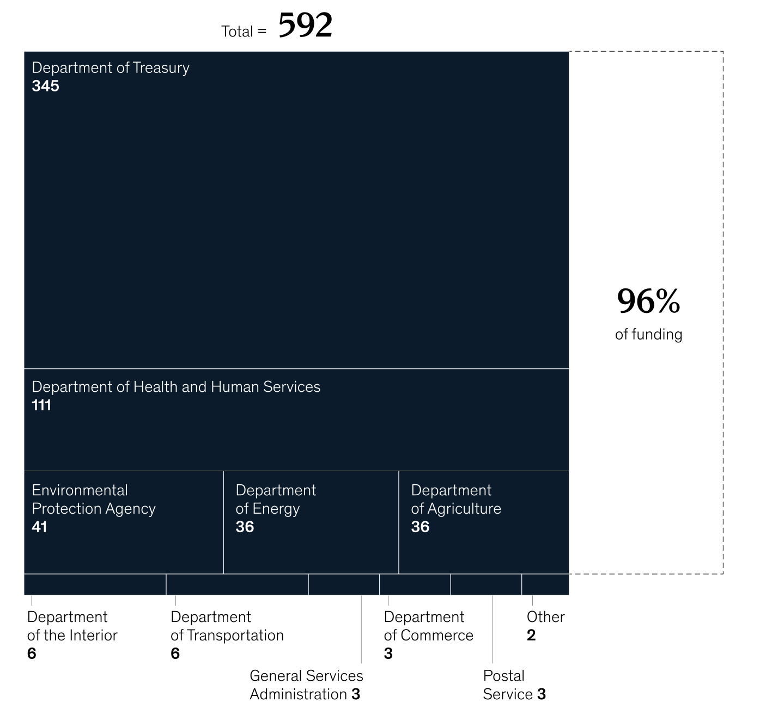
Inflation Reduction Act

Slide 10
2022 Inflation Reduction Act
CHIPS Act
Direct Funding
$280 Billion
$178 B
IIJA
Consumer
$550 Billion
$43 B*
IRA
Commercial
$500 Billion*
$173 B*

Slide 11
2022 Inflation Reduction Act
CHIPS Act
Direct Funding
$280 Billion
$178 B
IIJA
Consumer
$550 Billion
$43 B*
IRA
Commercial
$500 Billion*
$173 B*

Slide 12
IRA Commercial Energy Incentives
30C - Alt. Fuel Vehicle Refueling
Direct $
45X – Advanced Manufacturing
$178 B
45Q – Carbon Sequestration
45V – Clean Hydrogen
Consumer
45 – Energy Production Tax Credit
$43 B
45U – Nuclear Power Zero-Emissions
45Y – Clean Electricity
Commercial
48 – Energy Investment Tax Credit
$173 B*
48C – Advanced Energy Credit
48E – Advanced Energy Credit
179D – Buildings Efficiency Deduct.

Slide 13
IRA Commercial Energy Incentives
30C - Alt. Fuel Vehicle Refueling
Direct $
45X – Advanced Manufacturing
$178 B
45Q – Carbon Sequestration
45V – Clean Hydrogen
Consumer
45 – Energy Production Tax Credit
$43 B
45U – Nuclear Power Zero-Emissions
45Y – Clean Electricity
Commercial
48 – Energy Investment Tax Credit
$173 B*
48C – Advanced Energy Credit
48E – Advanced Energy Credit
179D – Buildings Efficiency Deduct.

Slide 14
Section 48 Investment Tax Credit
30C - Alt. Fuel Vehicle Refueling
Solar Power and Solar Thermal
45X – Advanced Manufacturing
Geothermal
45Q – Carbon Sequestration
Fuel Cells
45V – Clean Hydrogen
Combined Heat and Power
45 – Energy Production Tax Credit
Ground / H2O Source Heat
45U – Nuclear Power Zero-Emissions
Waste Energy Recovery
45Y – Clean Electricity
Energy Storage
48 – Energy Investment Tax Credit
Qualified Biogas
Microgrids
48C – Advanced Energy Credit
48E – Advanced Energy Credit

Slide 15
Section 48 Investment Tax Credit
30C - Alt. Fuel Vehicle Refueling
Solar Power and Solar Thermal
45X – Advanced Manufacturing
Geothermal
45Q – Carbon Sequestration
Fuel Cells
45V – Clean Hydrogen
Combined Heat and Power
45 – Energy Production Tax Credit
Ground / H2O Source Heat
45U – Nuclear Power Zero-Emissions
Waste Energy Recovery
45Y – Clean Electricity
Energy Storage
48 – Energy Investment Tax Credit
Qualified Biogas
Microgrids
48C – Advanced Energy Credit
48E – Advanced Energy Credit

Slide 16
Section 48 Investment Tax Credit
Solar
Smaller than
1MW AC
Geothermal
1 MW+ AC
Prevailing Wage & Apprenticeship
Fuel Cells
Combined Heat and Power
Ground / H2O Source Heat
Waste Energy Recovery
Energy Storage
1 MW+ AC
NO Prevailing Wage or Appnt’ship
Qualified Biogas
Microgrids

Slide 17
Section 48 Investment Tax Credit
Solar
Smaller than
1MW AC
30%
Geothermal
1 MW+ AC
Prevailing Wage & Apprenticeship
30%
Fuel Cells
Combined Heat and Power
Ground / H2O Source Heat
Waste Energy Recovery
Energy Storage
1 MW+ AC
NO Prevailing Wage or Appnt’ship
6%
Qualified Biogas
Microgrids

Slide 18
Section 48 Investment Tax Credit
Solar
Smaller than
1MW AC
30%
Geothermal
1 MW+ AC
Prevailing Wage & Apprenticeship
30%
Fuel Cells
Combined Heat and Power
Ground / H2O Source Heat
Waste Energy Recovery
Energy Storage
1 MW+ AC
NO Prevailing Wage or Appnt’ship
6%
Qualified Biogas
Microgrids

Slide 19
Prevailing Wage tiered system
Solar
Smaller than
1MW AC
30%
Geothermal
1 MW+ AC
Prevailing Wage & Apprenticeship
30%
Fuel Cells
Combined Heat and Power
Ground / H2O Source Heat
Waste Energy Recovery
Energy Storage
1 MW+ AC
NO Prevailing Wage or Appnt’ship
6%
Qualified Biogas
Microgrids

Slide 20
Investment Tax Credit Basics – 30% ex.
$1,000,000 total project cost
Solar owners can claim federal tax credit equal to 30% of the project cost.
$1,000,000 project = $300,000 credit

Slide 21
ITC: FOR PROFIT solar owner
3 ways to monetize the ITC
1. For Profit Owner, on their own Building
Building owners can claim federal tax credit equal to 30% of the project cost.
$1,000,000 project = $300,000 non-refundable credit
Depreciation deduction benefit, could be as much or more than the ITC value.

Slide 22
ITC: FOR PROFIT solar owner
3 ways to monetize the ITC
2. For-Profit Solar Owner, on someone else’s business
Solar owners claim federal tax credit equal to 30% of the project cost.
$1,000,000 project = $300,000 non-refundable credit
Depreciation deduction benefit, could be as much or more than the ITC value.

Slide 23
ITC: FOR PROFIT solar owner
3 ways to monetize the ITC
3. For-Profit Solar Owner, on someone else’s business
Solar owners or Building Owners cannot claim federal tax credit equal to 30% of the project cost.
$1,000,000 project = $300,000 non-refundable credit
Solar Owners sell the ITC to an outside party for cash (IRA new section §6418).

Slide 24
ITC: NON PROFIT solar owner
2 ways to monetize the ITC
1. For-Profit Solar Owner, on non-profit-building
Solar owners claim federal tax credit equal to 30% of the project cost.
$1,000,000 project = $300,000 non-refundable credit
Depreciation deduction benefit, could be as much or more than the ITC value.

Slide 25
ITC: NON PROFIT solar owner
2 ways to monetize the ITC
2. Non-profit Solar Owner, on anyone’s building
Non-profit solar owners claim federal tax credit equal to 30% of the project cost.
$1,000,000 project = $300,000 non-refundable credit
No depreciation benefit.
Solar Owners claim Elective Payment (IRA § 6417)

Slide 26
ITC “Elective Payment” and Transfer
ENERGY PROPERTY OWNER CAN USE ONE OF THE TWO NEW MONETIZATION PATHS:
1. 6417 “Elective Payment”
Tax-Exempt Organizations, including:
a. Nonprofit Orgs
b. Governmental entities
c. Rural Electric Cooperatives
d. Tribal Governments and Tribal Entities
2. 6418 Transfer
Energy property owners who are not eligible for elective payment

Slide 27
ITC “Elective Payment” and Transfer
ENERGY PROPERTY OWNER CAN USE ONE OF THE TWO NEW MONETIZATION PATHS:
1. 6417 “Elective Payment”
Tax-Exempt Organizations, including:
a. Nonprofit Orgs
b. Governmental entities
c. Rural Electric Cooperatives
d. Tribes and Tribal Enterprises
2. 6418 Transfer
Energy property owners who are not eligible for elective payment

Slide 28
ITC: NON PROFIT – Elective Payment
MUST OWN the Solar System for at least 5 years – still subject to “recapture” rules
Tax Exempt Entities include 501c3 and other nonprofits, as well as states and local governments and instrumentalities
No depreciation benefit
File on 990-T (Exempt Business Income Tax Return), along with forms 3468 and 3800
MUST pre-register intention of 6417 Elective Payment on IRS electronic portal

Slide 29
ITC: NON PROFIT – Elective Payment
Pre-registration steps:
Complete pre-filing via IRS portal
Receive registration number before making election
Receive property-specific number for each eligible solar property
Provide all information required by IRS as anti-fraud and anti-abuse measures.

Slide 30
ITC: NON PROFIT – Elective Payment
SPECIAL RULES FOR GRANT TREATMENT
TAX EXEMPT INCOME GRANTS REDUCE THE CREDIT:
no more than 100% of project costs “grant + credit” if grant specific purpose is construction, installation, equipment, etc…
Example: $1,000,000 project cost
ITC basis $1,000,000
ITC @ 30% $ 300,000
Grant $ 750,000 tax-exempt income
Total Credit $ 250,000 (ITC reduced by $50,000)
e

Slide 31
ITC: TRANSFER
ITC BUYER (the “transferee”) FACES SAME COMPLIANCE AS IF THEY WERE ORIGINAL OWNER OF ENERGY PROPERTY.
Recapture exposure for 5 years.
ITC Buyer must meet passive income rules to monetize the credit
3-year lookback and 22-year carryforward
MUST pre-register intention of 6418 Transfer on IRS electronic portal

Slide 32
Section 48 Investment Tax Credit
Solar
Smaller than
1MW AC
30%
Geothermal
1 MW+ AC
Prevailing Wage & Apprenticeship
30%
Fuel Cells
Combined Heat and Power
Ground / H2O Source Heat
Waste Energy Recovery
Energy Storage
1 MW+ AC
NO Prevailing Wage or Appnt’ship
6%
Qualified Biogas
Microgrids

Slide 33
ITC CREDIT BONUSES
Low Income Bonus Credit – 20%
20%
Low Income Bonus Credit – 10%
Domestic Content Bonus
10%
Energy Communities Bonus
10%
”Base” ITC
30%

Slide 34
ITC CREDIT BONUSES
Low Income Bonus Credit – 20%
20%
Low Income Bonus Credit – 10%
Domestic Content Bonus
10%
Energy Communities Bonus
10%
”Base” ITC
30%

Slide 35
ITC CREDIT BONUSES
Low Income Bonus Credit – 20%
20%
Low Income Bonus Credit – 10%
Domestic Content Bonus
10%
Energy Communities Bonus
10%
”Base” ITC
30%

Slide 36
ITC CREDIT BONUSES
Low Income Bonus Credit – 20%
Brownfields
“Statistical Area” w/ either:
a. 0.17%+ fossil fuel employment -or-
b. 25%+ tax revenue from fossil fuels
3. Coal Closure Category
a. closed coal mine area since 2000 -or-
b. coal power plant retired since 2010.
20%
Low Income Bonus Credit – 10%
Domestic Content Bonus
10%
Energy Communities Bonus
10%
”Base” ITC
30%

Slide 37
ITC CREDIT BONUSES
Low Income Bonus Credit – 20%
20%
Low Income Bonus Credit – 10%
Domestic Content Bonus
10%
Energy Communities Bonus
10%
”Base” ITC
30%

Slide 38
ITC CREDIT BONUSES
Low Income Bonus Credit – 20%
20%
Low Income Bonus Credit – 10%
Domestic Content Bonus
Domestic Content Bonus
10%
10%
Energy Communities Bonus
10%
”Base” ITC
30%

Slide 39
ITC CREDIT BONUSES
Low Income Bonus Credit – 20%
ALL STRUCTURAL STEEL & IRON U.S.-made
40% of all MANUFACTUREDPRODUCTS either 100% U.S.-made or “deemed to be U.S.-made” for 2023 and 2024 projects.
“Meant to be a bonus.”
- Treasury officials
20%
Low Income Bonus Credit – 10%
Domestic Content Bonus
Domestic Content Bonus
10%
10%
Energy Communities Bonus
10%
”Base” ITC
30%

Slide 40
ITC CREDIT BONUSES
Low Income Bonus Credit – 20%
20%
Low Income Bonus Credit – 10%
Domestic Content Bonus
10%
Energy Communities Bonus
10%
”Base” ITC
30%

Slide 41
ITC CREDIT BONUSES
Cat 1: Located in Low-Income Community
800 MW
Cat 2: Located on Indian Land
200 MW
Low Income Bonus Credit
Low Income Bonus Credit – 10%
10%
Domestic Content Bonus
10%
Energy Communities Bonus
10%
”Base” ITC
30%

Slide 42
ITC CREDIT BONUSES
Low Income Bonus Credit
Cat 3: Qualified Low-Income Residential Building Project
224.8 MW
Cat 4: Qualified Low-Income Econ. Benefit
900 MW
20%
Low Income Bonus Credit – 10%
Domestic Content Bonus
10%
Energy Communities Bonus
10%
”Base” ITC
30%

Slide 43
ITC CREDIT BONUSES
Low Income Bonus Credit
MUST HAVE ALLOCATION LETTER FROM IRS BEFORE SOLAR IS
“PLACED IN SERVICE.”
20%
Low Income Bonus Credit – 10%
Domestic Content Bonus
10%
Energy Communities Bonus
10%
”Base” ITC
30%

Slide 44
ITC CREDIT BONUSES
MUST HAVE ALLOCATION LETTER FROM IRS BEFORE SOLAR IS
“PLACED IN SERVICE.”
Low Income Bonus Credit
Low Income Bonus Credit – 10%
10%
Domestic Content Bonus
10%
Energy Communities Bonus
10%
”Base” ITC
30%

Slide 45
IRA Commercial Energy Incentives
30C - Alt. Fuel Vehicle Refueling
Direct $
45X – Advanced Manufacturing
$178 B
45Q – Carbon Sequestration
45V – Clean Hydrogen
Consumer
45 – Energy Production Tax Credit
$43 B
45U – Nuclear Power Zero-Emissions
45Y – Clean Electricity
Commercial
48 – Energy Investment Tax Credit
$173 B*
48C – Advanced Energy Credit
48E – Advanced Energy Credit
179D – Buildings Efficiency Deduct.

Slide 46
subtitle
Q&A

Slide 47
Contact
Jeremy Kalin
Impact Counsel Attorney
jkalin@avisenlegal.com

